Slide 1
PLANNING
CT026-3-1-Systems Analysis and Design

Slide 2
Topic Learning Outcomes
At the end of this topic, you should be able to:
1. Define problem statement
2. Describe the purpose of System Change Request
3. Explain the importance of preliminary investigation

Slide 3
Contents & Structure
Problem Statement
System Change Request
Preliminary Investigation

Slide 4
Key terms you must be able to use
If you have mastered this topic, you should be able to use the following terms correctly in your assignments and exams:
Planning
System request

Slide 5
Recap From Last Lesson
How many phases in SDLC?

Slide 6
System Planning Phase
Systems planning phase is the fundamental process of understanding why an information system should be built and determine how the project team will go about building it.
The activities in the planning phase can be divided into two (2) major steps:
Project Initiation (Project Identification)
Preliminary Investigation (Feasibility Study)

Slide 7
Project Initiation
Begins when someone in an organization identifies that there is a need to improve an existing system or a new system is needed to improve business operations.
Most ideas come from outside the IT department such as marketing, accounting, and etc., as a form of systems request.
Project initiation can be divided into several sub-steps:
System Request
Reasons for System Request (new or enhancement)
Sources of System Request

Slide 8
System Request
Every organization has its own way of initiating a project, but most start with a technique called systems request.
A formal way of asking for assistance from the information systems department.
Systems request documents the business reasons for building the system and the value that the system is expected to provide.
When the project is initiated, business users complete this form as part of the system approval process within the organization.
Might propose:
enhancements for an existing system,
the correction of problems
the development of an entire new information system

Slide 9
Sample of System Request
SYSTEM REQUEST FORM
Date Department:
Submitted by: Location:
Title: Email:
REQUEST FOR: URGENCY
Correction of system issue Immediate attention required
System enhancement Handle in normal priority sequence
new system Defer until new system is developed
DESCRIPTION OF THE REQUEST
(ATTACH ADDITIONAL DOCUMENT IF NECESSARY)
To be completed by the IT department
approved Assigned to IT contact person:
modified (see attach notes) User:
rejected (see attach notes) Urgency code: low high
Date: Action:

Slide 10
System Request
Systems Request Forms
Streamlines the request process
Ensures consistency
Easy to understand
Includes clear instructions
Indicates what supporting documents are needed
Most companies use online system request forms that users submitted electronically

Slide 11
System Requests
Systems Review Committee
Most large companies use a systems review committee to evaluate systems request
With a broader viewpoint, a committee can establish priorities more effectively than an individual
One person’s bias is less likely to affect the decisions
Disadvantages:
Action on requests must wait until the committee meets
Members might favor projects requested by their own departments
Internal political differences could delay important decisions

Slide 12
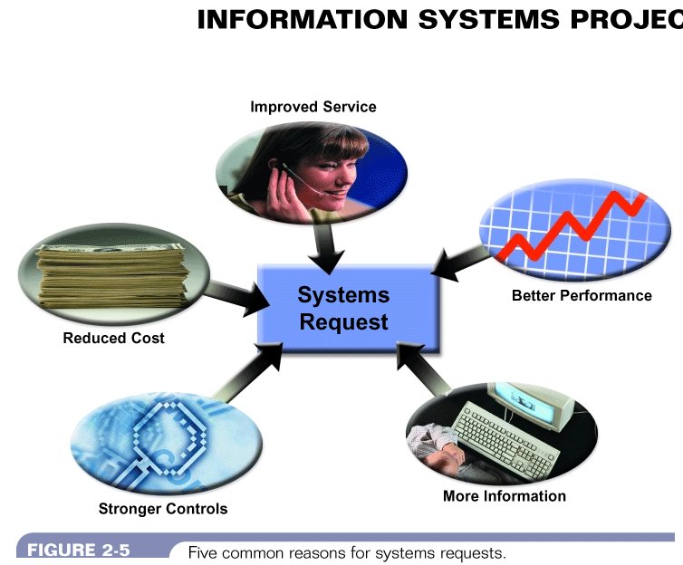
Reason for System Request
Figure 5-3: Five common reasons for systems request
Systems Analysis & Design (4th Edition) – Shelly Cashman Series

Slide 13
Reasons for system change request
Improve service
Systems requests are often aimed at improving service to customers, suppliers, or users within the company.
Can check balance
Can register online
Better performance
The current system might not meet performance requirements.
slow to respond to data inquiries
unable to support company growth
system becomes obsolete when new h/w is introduced

Slide 14
Reasons for system change request
More information
The system might produce information that is insufficient, incomplete, or unable to provide company’s changing information need.
May not be able to analyze market trends
Stronger controls
The system might need better security and support functionalities.
Passwords / encryption
Reduced costs
Expensive to operate & maintain old sys
New system more cost effective & better support for long term objectives

Slide 15
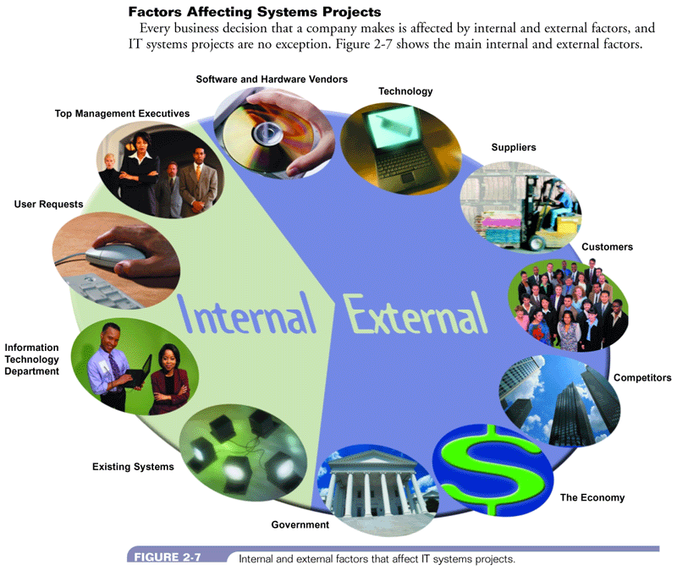
Factors affecting System Request
Figure 5-4: Internal and external factors that affect IT systems projects
Systems Analysis & Design (4th Edition) – Shelly Cashman Series

Slide 16
Preliminary Investigation Overview
A systems analyst conducts a preliminary investigation to study the systems request and recommend specific action.
The analyst gather facts about the problem or opportunity, project scope and constraints, project benefits and estimated development time and cost.
The end product of the preliminary investigation is a report to the management.

Slide 17
Problem Statement
After understanding the project initiation, the system analyst have to defines the problems and objectives of the system.
These will form the foundation of determining what needs to be accomplished by the system.
A problem definition usually contains some sort of problem statement, summarized in a paragraph or two.
This is followed by a series of issues, or major, independent pieces of the problem.
Issues are the current situation.

Slide 18
Sample#1 Problem Statement
Library Management System
In our existing system all the transaction of books are done manually, so taking more time for a transaction like borrowing a book or returning a book and also for searching of members and books. Another major disadvantage is that to preparing the list of the books borrowed and the available books in the library will take more time, currently it is doing as a one day process for verifying all records. So after conducting the feasibility study we decided to make the manual Library management system to be computerized.

Slide 19
Sample#2 Problem Statement
Hostel Management System
EXISTING SCENARIO:
All the work is done manually. Different copies of the student information are keep for different departments.
Room is allotted according to the room requirements and other special facilities demanded by the student.
Room categorise: Single, Double, Air-Conditioned and Corner.
Payment mode: Cash, Cheque and Draft.
Hostel facilitates and charges and other information are all kept in a booklet.
Student’s information, staff information, fee records, student check-in and check-out, room status, staff’s salary all these information are kept in registers.
All calculations relating to student’s fee, staff salary, fines and penalties, hostel funds are done manually.

Slide 20
Project Objectives
Problem Statement or issues are followed by a series of objectives, or goals that match the issues point by point. Issues are the current situation; objectives are the desired situation.
The objectives may be very specific or worded using a general statement.
At times the analyst may have to do a follow-up interview to obtain more precise information about the objectives.

Slide 21
Defining Project Objectives
After the objectives are stated, the relative importance of the issues or objectives must be determined.
The identification of the most critical objectives is best done by users (with the support of analysts), because users are domain experts in their business area and in how they work best with technologies in the organization.
One technique is to ask the users to assign a weight for each issue or objective of the first draft of the problem definition.
The problem definition issues and objectives are re-sequenced in order of decreasing importance.
Each objective is used to create user requirement.

Slide 22
Defining Project Objectives
Examples of Objectives:
To provide a Web system for customers to obtain pricing information and place orders.
To create or purchase a human resources system with a scheduling component.
To provide Web access to their account and a means for them to update the number of guests. Notify management of changes.
To provide a means to determine overall quantities of supplies for events occurring within a concurrent time frame.
To provide a system for communicating changes to key personnel at event facilities.
To store all event data and make summary information available in a variety of formats.

Slide 23
Summary
The analyst first defines the problems and objectives of the system
System Change Request is the starting point for modifying an information systems
A systems analyst conducts a preliminary investigation to study the systems request and recommend specific action.

Slide 24
Defining Project Scope
Determining the project scope means defining the specific boundaries, or extent, of the project. For example:
Very general:-
Payroll is not being produced accurately.
The project scope is to modify the accounts receivable system.
Very specific:-
Overtime pay is not being calculated correctly for production workers on the second shift at the Yorktown plant.
The project scope is to allow customers to inquire online about account balances and recent transactions.

Slide 25
Defining Project Scope
Some analysts find it helpful to define project scope by creating a list with sections:
Must Do
Should Do
Could Do
Won’t Do
Reviewed later, during the systems analysis phase, when the systems requirements document is developed.
Projects with very general scope definitions are at risk of expanding gradually – project scope creep.
Use a graphical model that shows the systems, people, and business processes that will be affected.
Boundaries of the preliminary investigation.

Slide 26
Defining Project Scope
Along with defining the scope of the project, you need to identify any constraints on the system - requirement or condition that the system must satisfy or an outcome that the system must achieve.
A constraint can involve hardware, software, time, policy, law, or cost. For example:
The system must operate with existing hardware, that is a constraint that affects potential solutions.
The order entry system must accept input from 15 remote sites.
The human resources information system must produce statistics on hiring practices.
The new Web site must be operating by March 1.

Slide 27
Project Management Tools & Techniques
GANTT Chart
a horizontal bar chart that graphically displays the time relationships between the different tasks in a project
effective when seeking to communicate schedule

Slide 28
Gantt Chart
Horizontal axis : Time and duration
Vertical axis : Activities - arranged from top to bottom in the order of their start date.
Horizontal position : start and end of the activity.
Length : Duration
Darkened portion : part of the activity that has been completed
“c” is marked when the activity is fully completed
Gantt Chart : It does not indicate activity dependencies

Slide 29
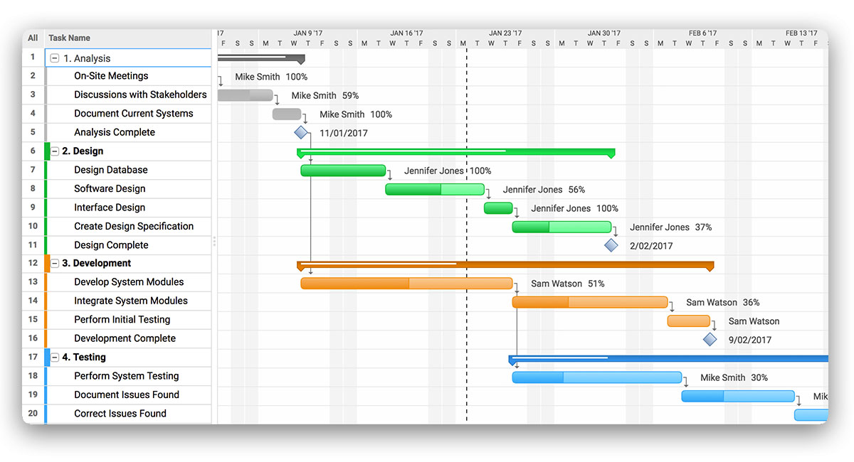
Gantt Chart

Slide 30
Gantt Chart
black bars – summary tasks – project phases
red bars – tasks that are critical to the schedule – any extension to the duration will delay other tasks
blue bars – tasks that are not critical to the schedule – they have slack time – delays will not affect other tasks & project as a whole
red arrows – prerequisites between two critical tasks
blue arrows – prerequisites between two non-critical tasks
teal diamonds – milestones – signifies the end of some significant task / deliverable

Slide 31
Gantt Chart
WBS – Work breakdown structure
The process of dividing the project into manageable tasks and logically ordering them to ensure a smooth transition between tasks
hierarchical decomposition of project into phases, activities & tasks

Slide 32
Gantt Chart
Decomposition is as follows :
1 Phase 1 of the project
1.1 Activity 1 of Phase 1
1.1.1 Task 1 of Activity 1 in Phase 1
1.1.2 Task 2 of Activity 1 in Phase 1
1.2 Activity 2 of Phase 1 ...
2 Phase 2 of the project ...

Slide 33
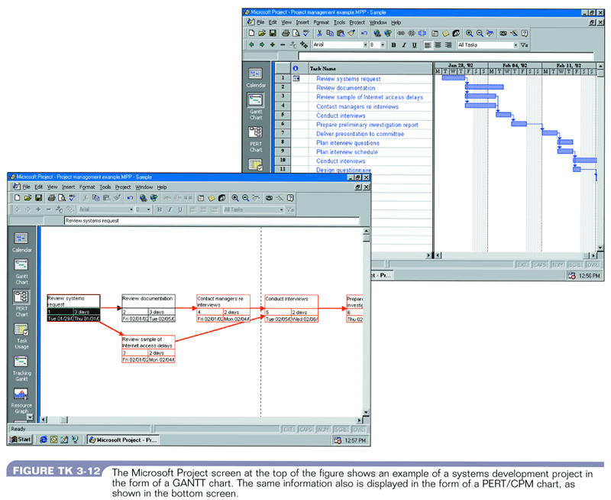
Project Management Software - MsProject

Slide 34
Keys to project success
Successful systems must :
Satisfy business requirements
Meet users’ needs
Stay within budget
Be completed on time

Slide 35
Some reasons for project failure
Unclear requirements, targets, or scope
Shortcuts or sloppy work
Poor design choices
Insufficient testing or test procedures
Lack of software change control
Changes in culture, funding or objectives
Unrealistic cost estimates
Poor monitoring and control of progress
Inadequate reaction to early signs of problems
Failure to recognize activity independencies
Personality conflicts and employee turnover

Slide 36
Preliminary Investigation Overview
A systems analyst conducts a preliminary investigation to study the systems request and recommend specific action
The analyst gather facts about the problem or opportunity, project scope and constraints, project benefits and estimated development time and cost
The end product of the preliminary investigation is a report to the management

Slide 37
Preliminary Investigation Overview
Interaction with Managers and Users
Meet with key managers, users, and IT staff to describe the project, explain responsibilities, answer questions, and invite comments
Focus on improvements and enhancements, not problems

Slide 38
Preliminary Investigation Overview
One or more systems analyst investigate a systems request to determine the true nature and scope of the problem and recommend whether it is worthwhile to continue the project
purpose :
gather enough information to determine if the information or problems specified in the systems request warrant
conducting subsequent phases of the SDLC

Slide 39
Preliminary Investigation Activities
Present Results and Recommendations to Management
Typical Report Includes:
Introduction
Systems Request Summary
Findings
Case for Action
Project Roles
Time and Costs Estimates
Expected Benefits
Appendix

Slide 40

Preliminary Investigation Report
Figure 5-11: Sample of a Preliminary Investigation Report
Systems Analysis & Design (4th Edition) – Shelly Cashman Series

Slide 41
References
Essential Reading
J.W. Satzinger, R.B. Jackson, S.D. Burd (2016), Systems Analysis and Design in a Changing World 7th Edition, Cengage Learning; ISBN: 1305117204
J.A. Hoffer, J. George, J.S. Valacich (2014), Modern Systems Analysis and Design 7th Edition, Pearson; ISBN: 0132991306
Further Reading
H.J. Rosenblatt (2014), Systems Analysis and Design 10th Edition, Course Technology; ISBN: 12851713349
K.E. Kendall, J.E. Kendall (2014), Systems Analysis and Design 9th Edition, Pearson; ISBN: 0133023443

Slide 42
Review Questions
What is system request?

Slide 43
Summary
Preliminary Investigation Report

Slide 44
What To Expect Next Week
In Class
Preparation for Class
Feasibility Study
Download the slide and study for the next chapter.

